Slide 1
Landing Page

Slide 2


LOGO AND NAME OF THEMEPARK
HEADER
Tickets &
Passes
FAQ
Book now
Opening hours information
Click for previous carousel item
Language
select
Purchase button
Check cart
Ad about how this park is amazing with a nice picture of a family having fun!!!!!
Carousel Pictures with changing images at set interval
Click for next carousel item
BODY
Activity 1 Activity 2 Activity 3

Slide 3
Food Option 1 Food Option 2 Food Option 3
Hotels nearby
Transportation (car, bus, train)
Information about rides
5 Star review from fake customer…

Slide 4
Mascot photo 1
Mascot 1 information
Mascot 2 information
Mascot photo 2
Mascot photo 3
Mascot 3 information

Slide 5



Random photo from official instagram
Random photo from official instagram
Random photo from official instagram
Random photo from official instagram
Newsletter signup
Newsletter
Enter your email for the latest update and promotions
Awards to show off
Submit button
Term of Service
FOOTER
Official Partners
About Us
Copyright Information

Slide 6
Tickets & Passes

Slide 7
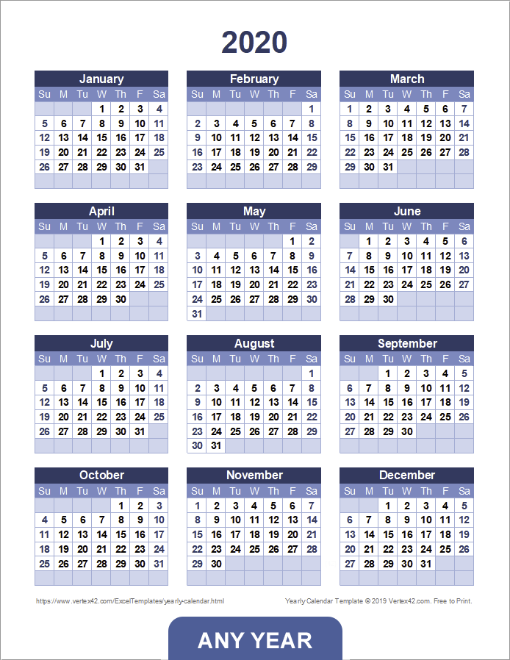
LOGO AND NAME OF THEMEPARK
HEADER
Tickets &
Passes
FAQ
Book now
Opening hours information
Click to change year
Boxes to choose How many people
Prices
Adults x $39.99
BODY
Children x $19.99
Enter voucher code
Total cost with breakdown
Calendar to choose booking date

Slide 8

Card Holder Name
Card number
Expires at MM YY
CVV
Pay now button
Term of Service
FOOTER
Official Partners
About Us
Copyright Information

Slide 9
FAQ´S

Slide 10
LOGO AND NAME OF THEMEPARK
HEADER
Tickets &
Passes
FAQ
Book now
Opening hours information
Frequently asked questions section

Slide 11
Name:
Text box
Email:
Text box
Your question:
Text box
Submit button
Term of Service
FOOTER
Official Partners
About Us
Copyright Information

